Slide 1
Information meeting for CEC, INES, GEOLOGY
2023-10-26

Slide 2
Today’s meeting agenda about the co-location and co-organisation of CEC, INES and Geology
Information about co-location and co-organisation projects at the faculty level
Karin Hall
CIG project overview – 2023
Karin Hall
Information from CEC, INES and Geology
Per Persson, Jonathan Seaquist and Anders Scherstén
Information from CEC´s, INES’ and geology’s representatives in the project working group
Yann Clough, Martin Berggren and Raimund Muscheler
CIG project overview – plans 2024
Karin Hall
Questions
Mingle with snacks and refreshments – Welcome

Slide 3
New conditions
After many years of growth, the universities are facing cuts.
A combination of rising costs and budget reductions makes a tight financial line necessary.
The faculty management has a responsibility to ensure that the faculty can continue to provide high-quality education and research in the long term.

Slide 4
Premises – high on the agenda
After staff costs, premises costs are the largest expenditure at our faculty and at Lund University as a whole.
The issue of premises and how to use these more efficient is therefore high on the meeting agenda of the faculty leadership.
A comprehensive work on our use of premises is needed.
Working more professionally with our premises aims not only to reduce costs…….

Slide 5
Current projects at the faculty level
Densification of premises in the Department of Physics, expected to be completed around 2023/24.
Ongoing review on densification of premises in the Department of Biology, report due on October 30, 2023.
Ongoing review on the possibilities to consolidate the subject libraries in the astronomy building, report due on October 30, 2023.
Ongoing review on how the astronomy building can be repurposed as a study center.
Science Village.
LTH and N-faculty common guidelines for office space allocation and office space standard.
The co-location and co-organisation of CEC, INES and the Department of Geology.

Slide 6
Meeting June 7, 2023
2021- May 2023
Orientation decision (”inriktningsbeslut”) by the Faculty Board, decided February 2023
Project plan, project organisation, delivery targets/objectives, steering committe members, project group members, decided May 2023
Today
Summary from June 7, 2023, to today
2024

Slide 7
CIG project overview – autumn 2023
  Project plan 2023 - delivery targets/objectives:
  The re-location of Computational Biology and Biological Physics (CBBP) from Fysicum to Geocentrum II.
  Test of scheduling to clarify the needs for undergraduate facilities prior to co-location.
  Premises program for co-location (lokalprogram).
  Identify specific issues for the continuation of the project in 2024.
  Risk and impact assessment of the co-location and merger including proposed measures.
  Report to the Board on activities and results achieved (meetings in June, September and November).
  Deliver a report to the Board on the achievement of the 2023 project objectives (meeting December).

Slide 8
We also have…
Organised two workshops
Talked with colleagues:
administration, education, centers, communication and collaboration, future learning environments, laboratories, library, postgraduate education
HoD/director assignments:
Administration
Education, bachelor’s and master’s level
Laboratories

Slide 9
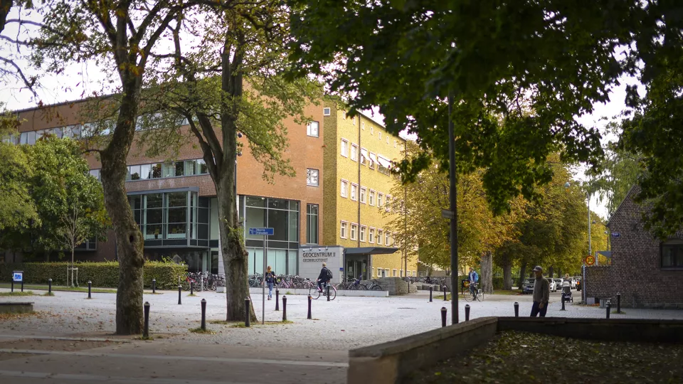
Photo: Petra Francke

Slide 10
CEC: processes before CIG
 | Organisation | Premises
2019 | Faculty review of CECs organisation and funding RQ20 starts | Lack of office space identified and defined Efforts to find short- and long-term solutions
2020 | RQ20 reports Staff day, theme: a new CEC mission | Continued work for long-term solution (partly interrupted by covid) Delivered an in-depth analysis of needs to LU Byggnad
2021 | New CEC mission, Director, Chairman and Board Internal report on Current & future cooperation & organisation of CIG | Staff day on future workplace, including lessons learned from covid Planning a partial move of CEC in dialogue with Geology
2022 | External CIG report and internal CEC network report presented | Move to Geology on hold
2023 | The computational biology & biological physics (CBBP) group from former Astronomy and theoretical physics merges with CEC Formal start of the CIG process | CBBP moves from premises at the Physics department to Geology

Slide 11
CEC: internal CIG process
Staff meetings Friday morning every week
  Some occasions with special focus on the CIG project with longer internal discussion
  One visit from Faculty coordinator of premises
  One visit from CIG project management
Staff newsletter sent out every second week with update on progress
Permanent item on the agenda of the management group meetings (every second week)
Administrative support to CEC representatives in Project group and Steering group. Also supports information sharing.

Slide 12
CIG@INES
Several fora were provided (at different stages) where opinions, feelings, and suggestions could be expressed and discussed
We have tried to be constructive at each stage
Result – INES has generated much in the way of documentation, ideas, and suggestions, that may be used by the CIG steering/project groups to help forge a common future

Slide 13
CIG@INES – Timeline of Milestones
May 2021 – online survey to collect ideas about RQ20 panel recommendations and the establishment of Science Village, followed by online Zoom discussion of results
April 2022 – group-wise SWOT analyses conducted across CIG dimensions (teaching, research, recruitment, etc.), in order to inform process and prepare for INES retreat
June 2022 – Workshop at INES retreat dedicated to defining ’desires, needs, challenges’ around CIG with the goal of delivering a statement to external panel during site visit during August
January 2023 – series of smaller group discussions with INES management in order to identify ’leverage points’ for improvement across CIG dimensions
February 2023 – Dean address INES’ questions (arising from above discussions) regarding CIG before ’inriktningsbeslut’ is taken by Faculty board
September 2023 – Short workshop focussing on communication around sub-project group themes (burnings issues within each sub-project group + how can sub-project groups best work within the sub-project)

Slide 14
CIG-process at Dept. of Geology
Consolidation of office and lab space
Welcoming CBBP to Geocenter 2
Staff meetings with CIG-relevant information every fortnight.
Workshop to redefine and consolidate existing research groups.
Following recommendations from the CIG steering group the
  CGB-kansli investigatees possibilities for increased collaboration and cooperation with the CEC administration
  The director of studies investigates possibilities for increased cooperation within basic education
  investigation of lab structure and coordinated use within the CIG framework.
Focus on our financial situation
Expect financial balance by 2025

Slide 15
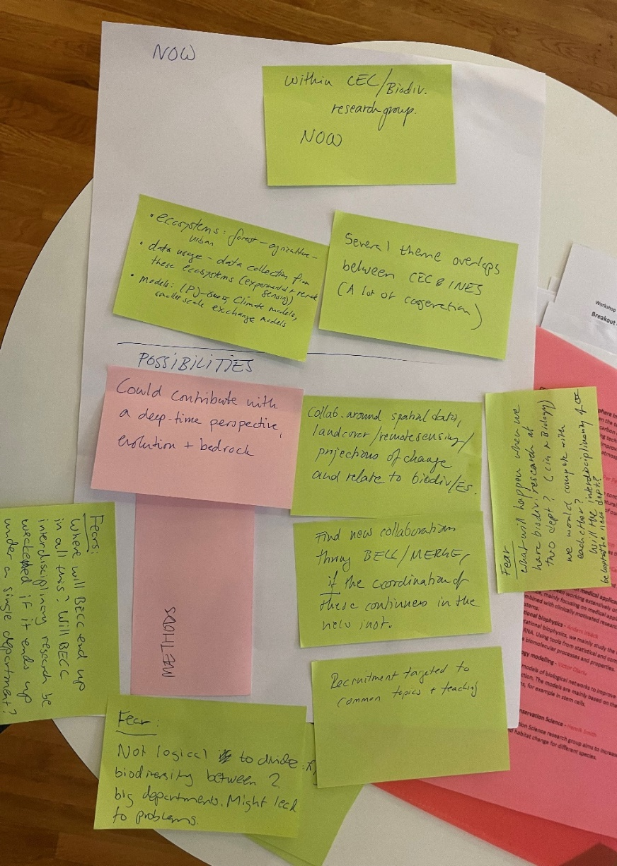
Some THM from theme/research group leader meeting (20th of Sept)
A lot of ongoing collaboration between CEC, INES and Geology, potential for much more.
Important:
  Concrete proposal/scenario for a merger...then that can be analysed from all angles
  Adequate bottom-up process
  Investment into the merger – Extra funds (PhD, Postdoc)?
  Enough meeting spaces (short supply already now)
  Adequate lunch space

Slide 16
Important right now
Premises program for co-location (lokalprogram)
Co-organisation
Plan for 2024
Project organisation and delivery targets/objectives

Slide 17
Proposed project organisation for 2024 regarding co-organisation, not yet approved
Line
Faculty board
Dean
Project group: coordinating, operational, project results
Steering committee
HoD/director: appoint working groups with assignments and task deskriptions
Administration
Education, bachelor’s and master’s level
Communication and collaboration
Future learning environments
IT
Laboratories
Postgraduate education
Research
Other suggestions?
Examples of significant issues:
Organisation
Economic policy
Profile, identity, name
Biology
Centers
Research infrastructures
Strategic research areas
Range of administrative matters
etc

Slide 18
End slide, logotype only

